Slide 1
Project Name
Battery Alarm

Slide 2
Group Members
Group Name: G.D.S Group
Mr.Sadam-Aladwr
Mr.Abdus-Salam
Mr.Abdul-lateef
Mr.Ali
Supervisor:
Sajid Ali Anjum
Conducted By:
Computer System Engineering

Slide 3
Experience Of Mobile Computing
Before:
Before attending the workshop we do not know any thing about Mobile computing
We don’t have any idea that which type of software is used to design which type of application
After:
After attending 4 days work shop we are now able to design mobile Application .
Now we are able to implement our thoughts practically in the world of mobile computing and programming.

Slide 4
Project Description
As We have just begun our programming life in C++ , So we don't have much experience in Java or JavaMe . But During our Course We study how to make logics For a Problem To solve it in Precise and in appropriate manner
So we Select Q.t as our developing Tool …We Started work on it. With the Guidance and through out Support of Sir Sajid Ali Anjum we were able to understand it, and we developed our first program “hello World“ just After Attending First day Work Shop

Slide 5
Abstract
Our Application is Designed on Q.t Sdk which was very suit able |IDE for us. It Was Also very much help Full For The beginners .
So we Designed our Battery Alarm Application on Q.T Sdk, by just using its two Simple A.p.is (Qsystem device info & Qsound)
By Using this application user would be able to know his actual mobile charging level and most of all it will be help full to secure your Cell battery from over charging

Slide 6
Why Battery Alarm
To Prevent Battery from Over charging:
To prevent battery From Cells damage disasters
To prevent Battery from Its Misbalance shape Which occur Due to extra charging
To Save energy .

Slide 7
How battery Alarm Helps you:
It Alarms you when Your battery if fully charged.
It will continuously Alarm until you get your mobile remove from the Charger.
It Will give you real battery charging status information.

Slide 8
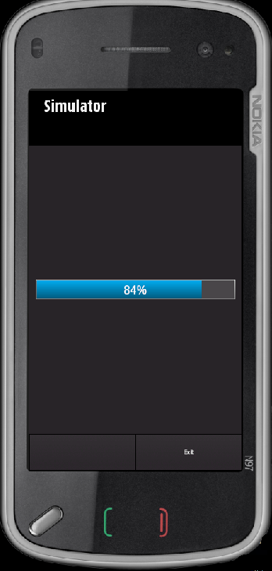
Battery Alarm:

Slide 9
Technical Aspects
capable to run on all Nokia symbain mobile
Very light application .
Short in size.
Takes less processor and ram load
We Guarantee You That It Will Saves You and Your mobile from any type of damage. And it has no Draw back

Slide 10
Efforts to develop the project
We worked on it from Dawn to dusk .
In whole this session there was just Q.t and our team.
Through this spirit we were first group to get our project submitted to Sir Sajid Ali Anjum before any group .
Thank You Sajid Ali for your help .

Slide 11
Appericiations:
We appreciate the Efforts of Our Supervisor Sajid Ali Anjum
And Computer System Engineering & Technology UCET , For conducting Such a honorable and Value able Event .
Thank You……………….

